Slide 1
Value Chain Hackers Start of Year conference September 2025

Slide 2

Icebreaker – what is a supply chain & its impact?

Slide 3
Kick-off agenda
Intro of the day, VCH & stakeholders
Structure of the semester, 5+3 steps
Where are you at + first ideation
Quick pitch of your ideas + first feedback
Next steps & commitments

Slide 4

Who are you?

Slide 5
What is VCH?

Slide 6

Problem
Wicked problems in supply chains need solutions that are
Socially and environmentally impactful and innovative
Financially viable
Scalable in practice
Many want to make a difference, but lack structure and support
Businesses part of supply chains
Institutions (e.g. Governments, certification or regulatory bodies)
Local communities (e.g. citizens, students, NGOs)
No coordination nor communication between acting parties

Slide 7
Our solution: a guided, applied approach
Applied learning
Stakeholder engagement
Iterative prototyping
A 6-months program from problem to scalable solution with Theory U
Focused on real-world transformation, not hypothetical case work
Contact and collaboration with businesses through the program
Mentorship and Feedback along with collective learning
Support after the program for the best groups to bring their solutions to the market

Slide 8




Our hybrid identity
Consultant
Activist
Structured problem-solving
Stakeholder alignment
Value creation logic
Data-driven strategy
Purpose-first thinking
Challenging the status quo
Community accountability
Moral courage & urgency
VCH

Slide 9
What you will work on
You will pick a problematic product or process from one of our tracks and to come up with a solution (impactful, viable, scalable) to remove the problem from the supply chain

Slide 10
The 8-steps process + Theory U
Data collection (Co-Sensing)
Solution ideation
(Co-Presencing)
Problem identification
(Co- Initiating)
Validation
(Co-Creating)
Proposal development
(Co-Actualizing)
Community engagement
Testing
Scaling
3

Slide 11
A 20-weeks program
Week # | Session | Duration | Date
2 | Kick-off | 2 hours | 11/09
3 | Workshops & crash courses | Full day | 18/09
5 | Brainstorm session | Half day | 2/10
7 | Inspiration session #1 | 2 hours | 16/10
10 | Roast day | 3 hours | 6/11
13 | Inspiration session #2 | 2 hours | 27/11
19 | Final check | 2 hours | 8/01
20 | Closure | 2 hours | 15/01
21 | Celebration | Half day | 22/01
Every 2nd Thursday of the month: online AI workshop from 15h-16h

Slide 12
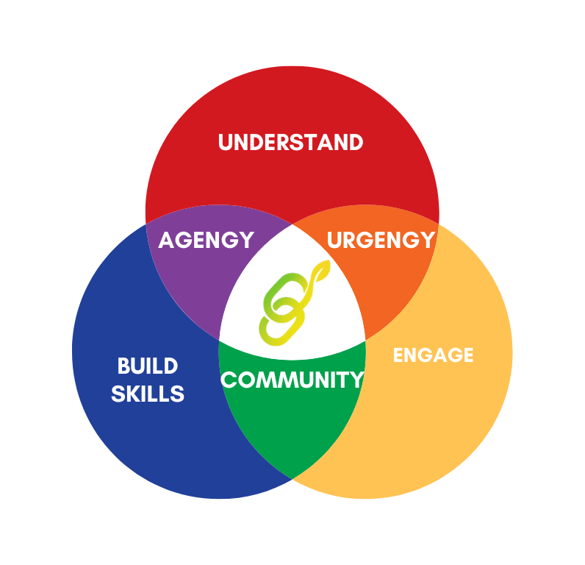
The enabling framework
You will need to…
… Understand the systems, tools, and contexts;
… Build skills, develop hard and soft skills;
… Engage, show motivation and commitment to action.
And will get in return:
Agency: I know what to do and how to do it, I feel capable;
Urgency: I know why it matters, and I’m emotionally engaged;
Community: I want to do this and I’m not doing it alone.

Slide 13



The tools
OpenWebUI
Our own in-house self-hosted AI platform
Provides help at every step of the process
No prior experience wih AI required, trainings provided for using AI well

Slide 14
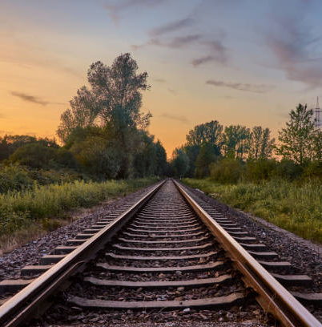
Our tracks
Select one track aligned with your challenge area, supported by partners and domain experts.

Slide 15
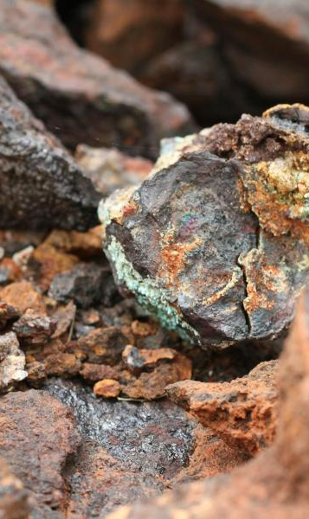
Critical raw materials
Our tracks
Focus: Geosciences – Supply Chain Management
Themes: Resilience of SCs, Social & Environmental sustainability, Sustainable and Ethical Sourcing, Geological and Climate risks, Recycling, Energy Transition, Geopolitical Risks
Applications: Ranging from urban mining to recycling, to alternative design, mining and material challenges, regulatory and tariff risks

Slide 16
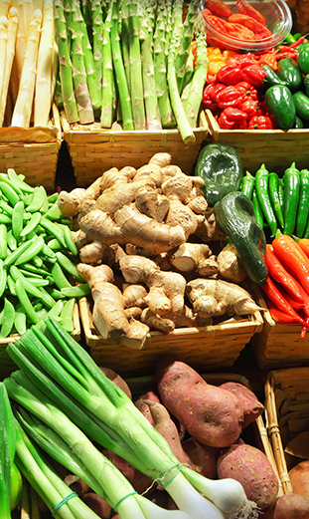
Agri-food supply chains
Our tracks
Focus: Sustainable SMEs & food networks
Themes: Regenerative agriculture, community resilience, food security
Applications: Food waste reduction, cooperative networks, alternative farming models

Slide 17
Important outcomes & deadlines
January 15th, 2026: final presentation
Pitch you idea to professionals!
No report, but a handover
We give you freedom to choose how you present your results
It should be understandable for the ones coming after you

Slide 18

Awards

Slide 19
Storyteller
Influencer
Innovator
You have convinced everyone your idea is going to change the world
Example to win: make a video about your idea/journey and have it seen by many
You have spread your idea to the most people in your network
Example to win: share frequently on LinkedIn & other socials, create an online community
Your idea has the most impact on the environment you have picked
Example to win: convince the jury, have someone already committing to working with you in the future

Slide 20

Where are you at & first ideation

Slide 21

Elevator pitch of your ideas, first feedback

Slide 22
Next steps

Slide 23
Next important dates
18th Sep – workshop day
2nd Oct – brainstorm session, half day
16th Oct – inspiration session, half day

Slide 24
Practicalities
Join/check access to various tools
Reach out to your coach (Rea & Maxime) & plan a 1st check up
Align with your team on work of the next weeks

Slide 25
General guidelines
Be open to criticism, ideas, help, work
Dare new and/or crazy things
Respect yourself and others
Ask! Especially to us, we can’t help you if you don’t
Have fun!

